Slide 1

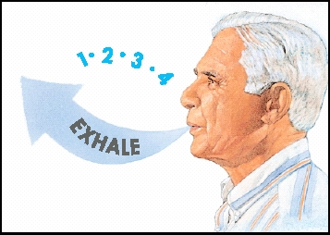
Pulmonary Rehabilitation Physiotherapist
Notes:
<number>

Slide 2

Congratulations
Notes:
<number>
On returning

Slide 3
What we will cover today
What is “good” breathing
What is “bad” breathing
Why do we breathe incorrectly
How can breathing incorrectly make us feel
What we can do about it
What to do when you are suddenly short of breath
How to breathe when you are exercising
Notes:
<number>

Slide 4
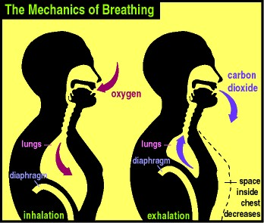
What is “good” breathing?
Diaphragm
  Marathon runner of all muscles
  Efficient 3% of energy
Nose
  Humidifer
  Filter
8-16 breaths a minute
In for count of 1 and out for count of 2
Notes:
<number>
Use accessory muscles when exercise
Nasal rinse

Slide 5
What is “bad” breathing?
Disordered breathing pattern
Breathing too much for what the body needs
Blow off too much carbon dioxide
Have too much adrenaline
  Fight and flight
  No rest and digest
Notes:
<number>

Slide 6
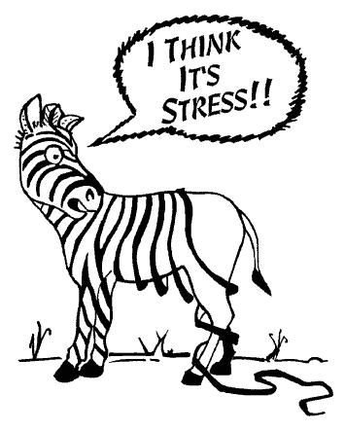
Why do be breathe incorrectly?
There is a time and place - acute stress
However it can become a habit
  Chronic illness
  Blocked nose
  Stress/ anxiety
Notes:
<number>
Nasal rinse - BD

Slide 7
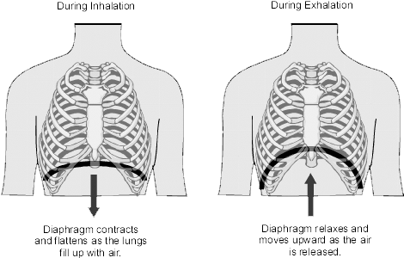
How does this happen?
Mouth breathing
Chest muscle overuse
Shoulder/ chest tension
Abdominal tension
All can lead to over breathing
and ultimately
poor diaphragm use
Notes:
<number>
Unwell with lung condition
Anxious about it
Pattern becomes chronic

Slide 8
Good breathing vs.
Disordered breathing
Stomach movement
Relaxed
Longer out breath
Nose breathing
Relaxed stomach and shoulders
Good diaphragm use
Upper chest movement
Fast or deep
Sighs, yawns
Mouth breathing
Tense stomach and shoulders
Diaphragm weakness
Notes:
<number>

Slide 9
How can it make us feel?
Many different signs and symptoms that affect everyone differently
Can affect the entire body
  Dizziness, nausea, chest pain, short of breath, suffocation feeling, air hunger, pins and needles, cramp, fatigue, poor memory…
Notes:
<number>

Slide 10
What can we do about it?
Self observation
  Place one hand on your stomach and one on your chest
  Drop shoulders, breath out and focus on movement of the lower hand
Practise in a comfortable position when you are relaxed
Try and breath in through your nose
Notes:
<number>
Hand on chest and stomach

Slide 11
Breathing retraining
Start lying on back
  Bend knees or place hands above head to make easier
  Can also lie on side or stomach
Think of posture changes
  Relax shoulders, stomach, legs
Focus on diaphragm use
  Feel stomach rise with breath in and fall with breath out
  Try to slow down the breath out
  Wheat bag on stomach for feedback
Notes:
<number>

Slide 12
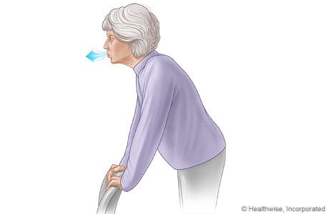
What to do when we are suddenly short of breath
Stop, drop and flop
  Stop what you are doing
  Try to sit or lie down,
  Lean forward
  Relax muscles
Focus on breath out
Try to slow breathing rate with longer breathe out
Forward leaning
Try this prior to ventolin use if you find yourself reaching for your ventolin often
Notes:
Flicker candle, purse lip breathing
<number>

Slide 13
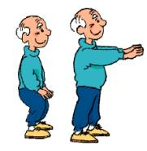
How to breathe when we are exercising?
Try and not hold your breath
Breathe out on bending activities
Drop your shoulders
We can help in class, just ask
Notes:
<number>

Slide 14
Summary
Practise good breathing when relaxed – aim for 2-3 times daily
3-4 breaths at a time
“Check” your breathing through out the day – relax your shoulders, breath out
If suddenly short of breath – Stop, Drop, Flop
Have a practise at home and talk to us about it in the next class.
Notes:
<number>
Morning, afternoon and night

